Slide 1
Meiosis
AEHBY Human Biology

Slide 2
Review
Cord blood cells may be used in the treatment of diseases far beyond blood diseases, due to their ability to differentiate. Explain why cord blood stem cells are more versatile than adult stem cells by discussing differentiation and potency. (6 marks)
In which phase of the cell cycle does the size and number of organelles increase? Why does this need to occur? (2 mark2)
Explain why, in one full circuit of the body, the blood will pass through the heart twice. (2 marks)
Describe three characteristics of alveoli that allow for efficient gas exchange and explain (3 marks)

Slide 3
Learning Intentions
Meiosis produces gametes for reproduction and involves DNA replication, chromosome pairing, and two successive nuclear divisions distributing haploid sets of chromosomes to each gamete.

Slide 4
Success criteria
Compare meiosis and mitosis, in terms of number of daughter cells, haploid/diploid, purpose and location.
Explain why meiosis is also called reduction division.

Slide 5
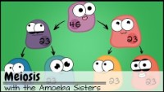

Slide 6
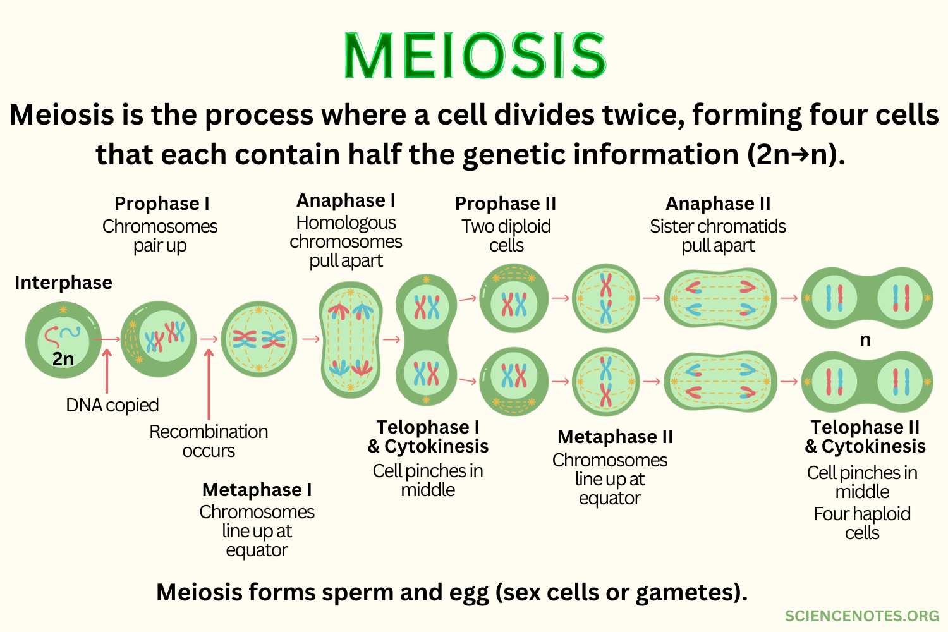

Slide 10
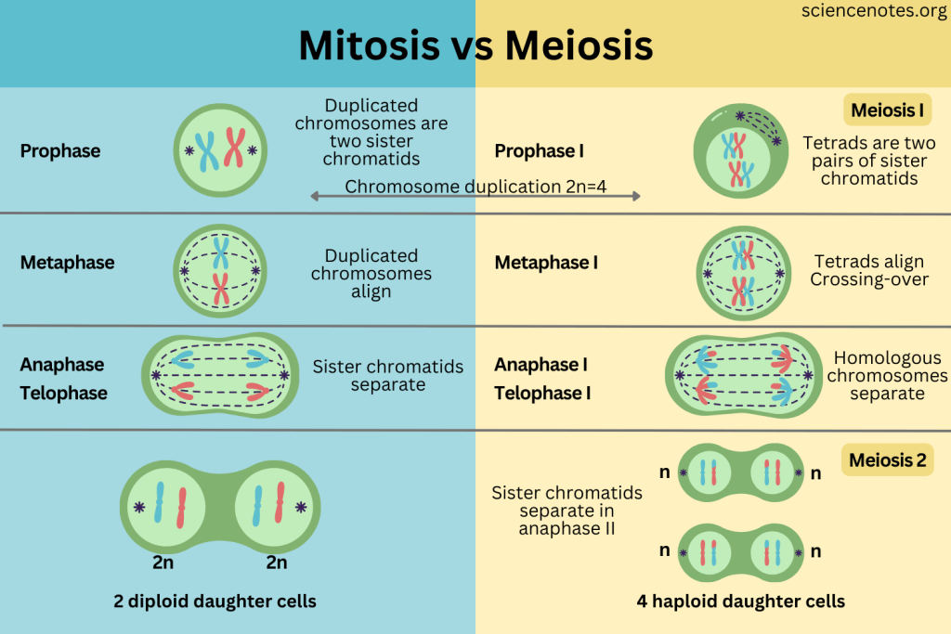

Slide 17
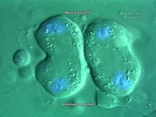

Slide 19
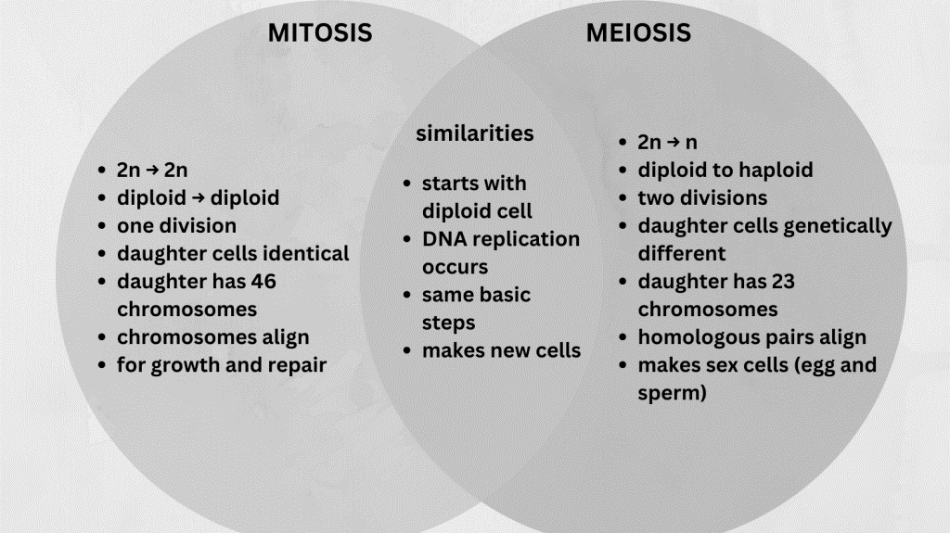
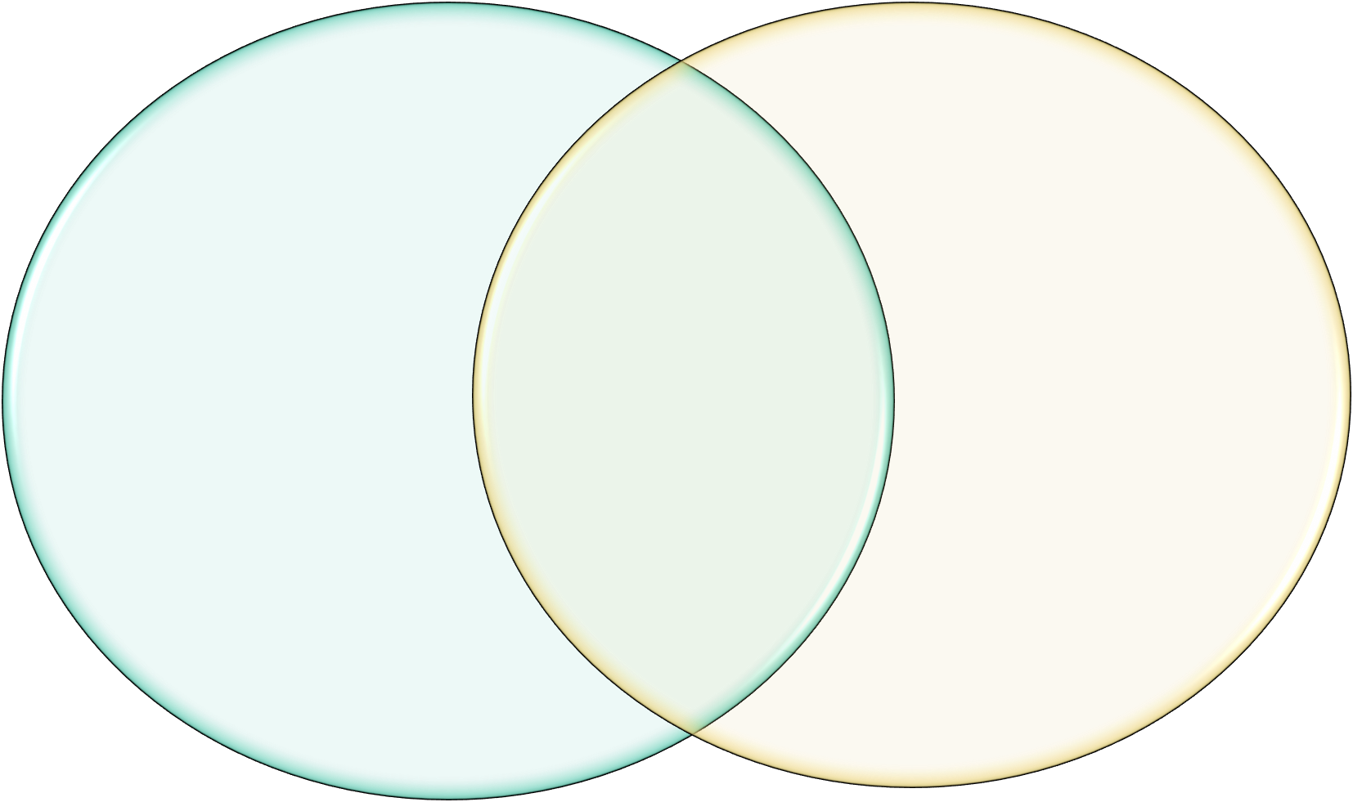

Slide 20
Success criteria
Compare meiosis and mitosis, in terms of number of daughter cells, haploid/diploid, purpose and location.
Explain why meiosis is also called reduction division.

